Slide 1

Voltage Stability Analysis for Power System with Dynamic Load –
Part 2:
Simulation model of the entire power system
Group 5:
Melanny Anaya
Ahmed Hassan
Mohamed Emam
Abdelrhman Rabea
Sebghatullah Misbah

Slide 2
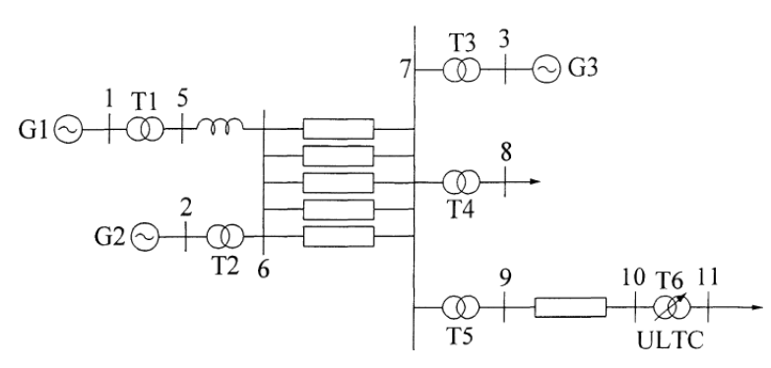
Considered power system

Slide 3

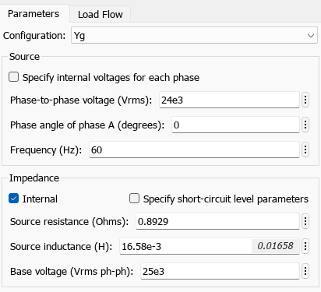
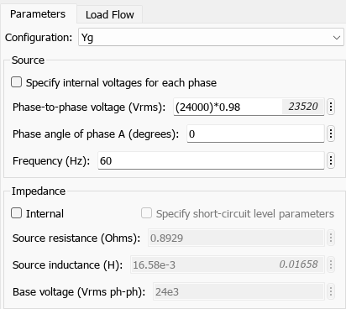
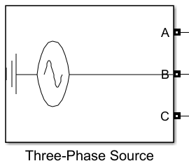
Generator 1
Infinite bus.
Asumption: V = 24 kV
Simscape block:

Slide 4
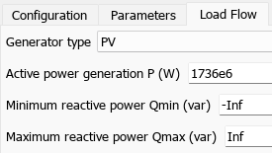
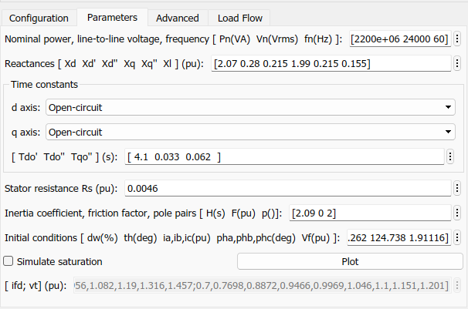


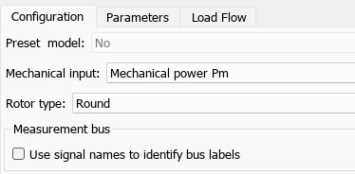
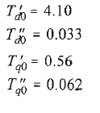
Generators 2 and 3
Synchronous machines pu Standard block was chosen due to the values already given. Only the Inertia Constant (H) and Active Power (P) differ between G1 and G2; all other settings were left at their default values.

Slide 5
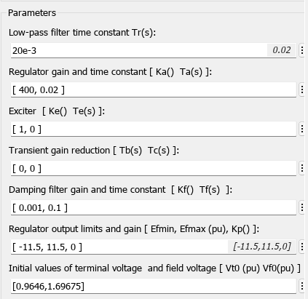
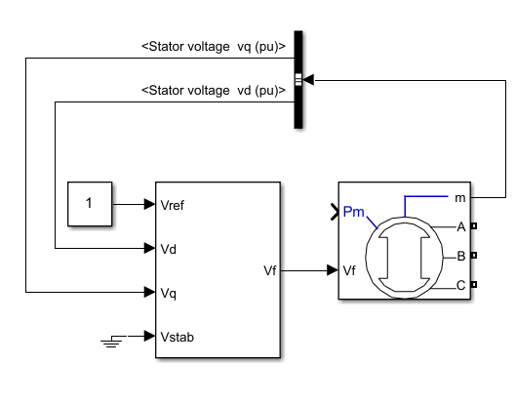
Excitation system
𝑉_{𝑑} and 𝑉_{𝑞} from the Generator are fed back to the AVR, which compares the measured voltage with 𝑉_{𝑟𝑒𝑓} and outputs the necessary Field Voltage
Most parameters are the model's default values.

Slide 6
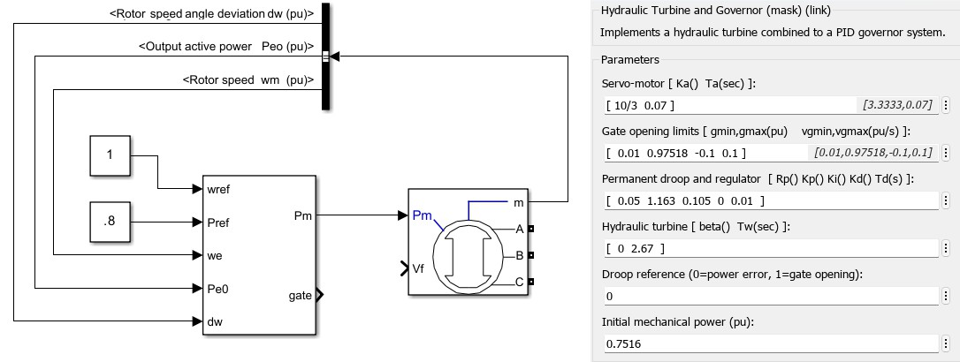
Turbine-governor system
Simulation model of the generators including excitation system and turbine governor system

Slide 7
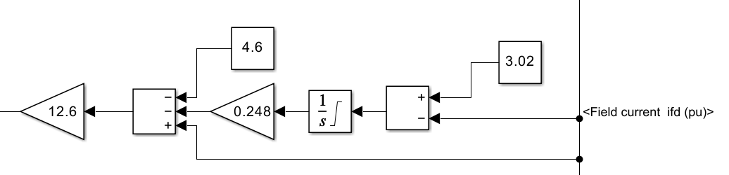
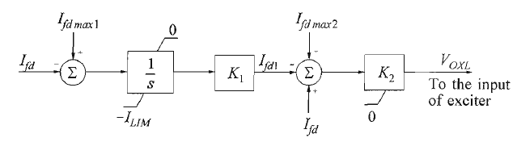
OXL Exciter for G3
Simulation model of the generators including excitation system and turbine governor system with the over excitation limiter is added to limit the field current.

Slide 8
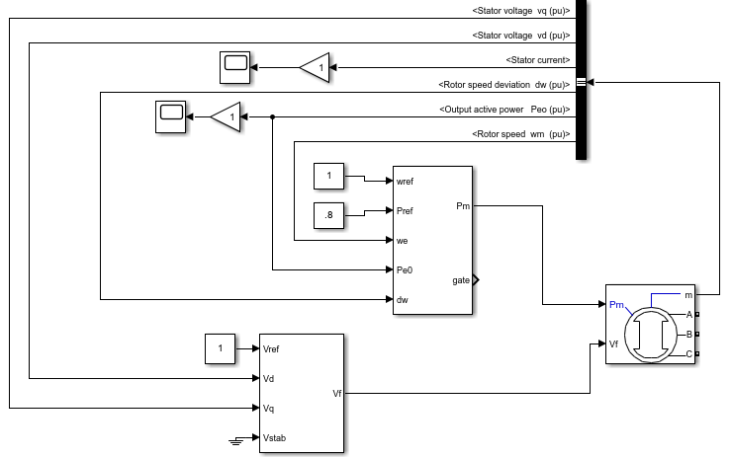
Control scheme for the SG

Slide 9
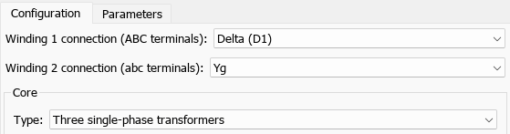
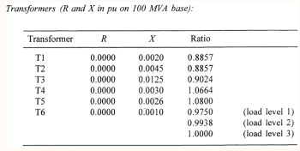
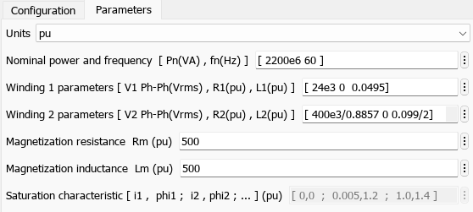
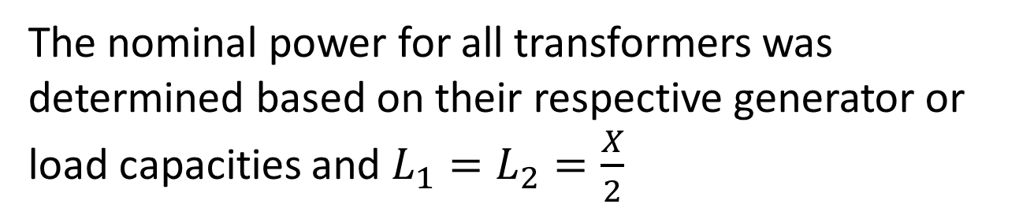
Transformers
The nominal power for all transformers was determined based on their respective generator or load capacities and $L_{1}=L_{2}=\frac{X}{2}$

Slide 10
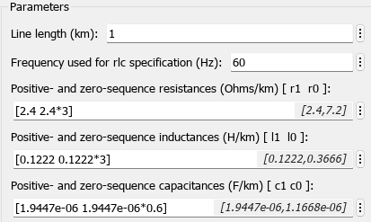
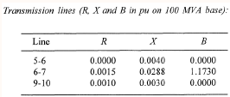
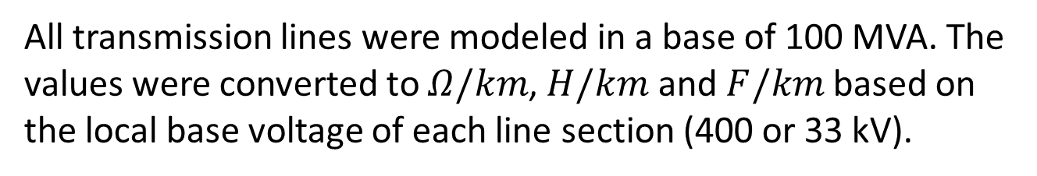
Lines
All transmission lines were modeled in a base of 100 MVA. The values were converted to $Ω/km$, $H/km$ and $F/km$ based on the local base voltage of each line section (400 or 33 kV).
$$Z_{base}=\frac{V_{base}^{2}}{S_{base}} ; R=R_{pu}∗Z_{base} ; X_{L}=X_{pu}∗Z_{base} L=\frac{X_{L}}{2πf} ; B=\frac{B_{pu}}{Z_{base}} ; C=\frac{B}{2πf}$$
Due to missing zero-sequence data, the zero-sequence parameters were assumed 3 times the positive-sequence for X and L and 0,6 times for C.

Slide 11
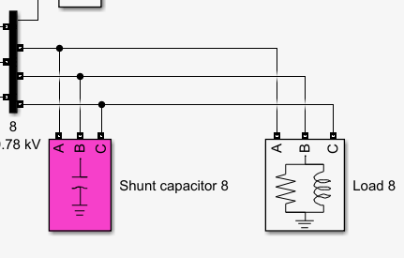
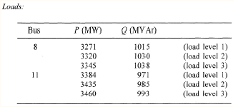
Shunt capacitors and loads
All loads and capacitor banks are connected in parallel (shunt) to the respective buses

Slide 12
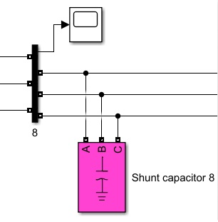
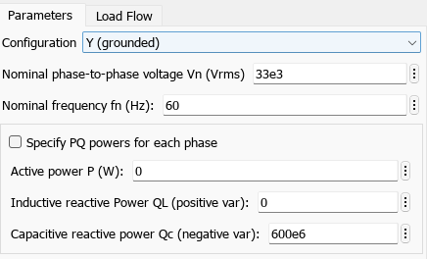
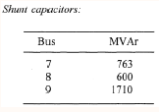
Shunt capacitors and loads
Modeled as pure capacitive elements using the Three-Phase Series RLC Load butsetting just the capacitive reactive power

Slide 13
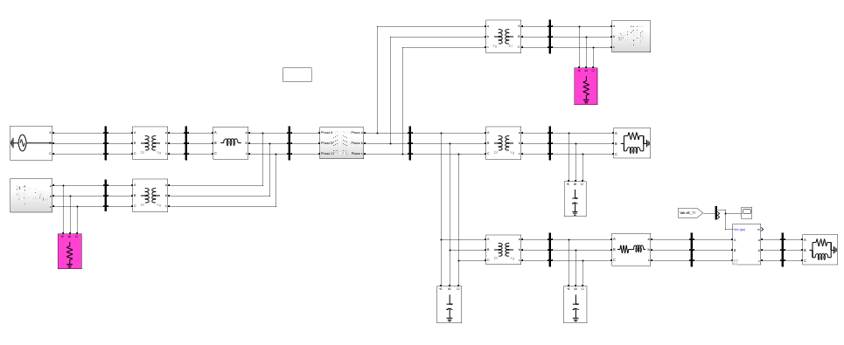
Overall System

Slide 14
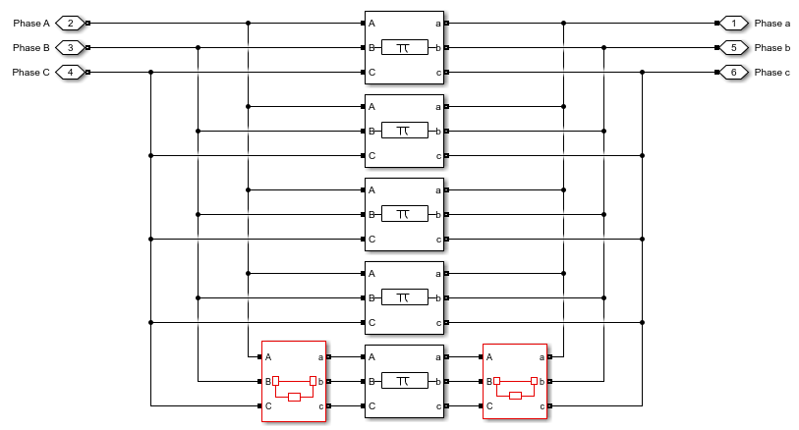
Perform Simulation Disturbance
N-1 contingency, corresponding to the permanent loss of one of the five parallel lines 6 - 7
Initial state: closed
Open at 10s

Slide 15
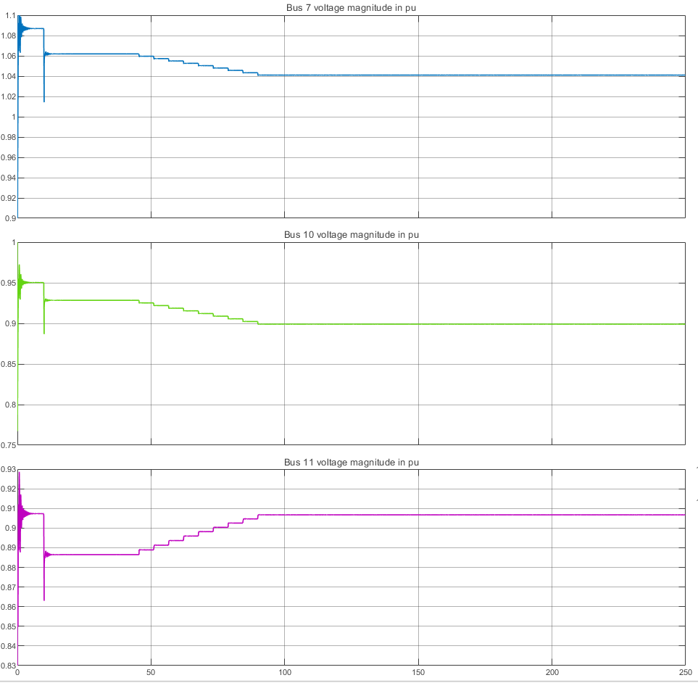
Perform Simulation Scenario 1
Load level 1 – Voltages at buses 7, 10 and 11
Following disturbance, the impedance increases and voltage drop across all buses
ULTC initiates tap changes and restored the Bus 11 voltage to near reference value
However, ULTC action reduces the impedance seen from the upstream network, which:
Increases current flow
Causes additional voltage drops at nearby buses
As a result, bus voltages at buses 7 and 10 decrease, even though the controlled bus voltage is restored.

Slide 16
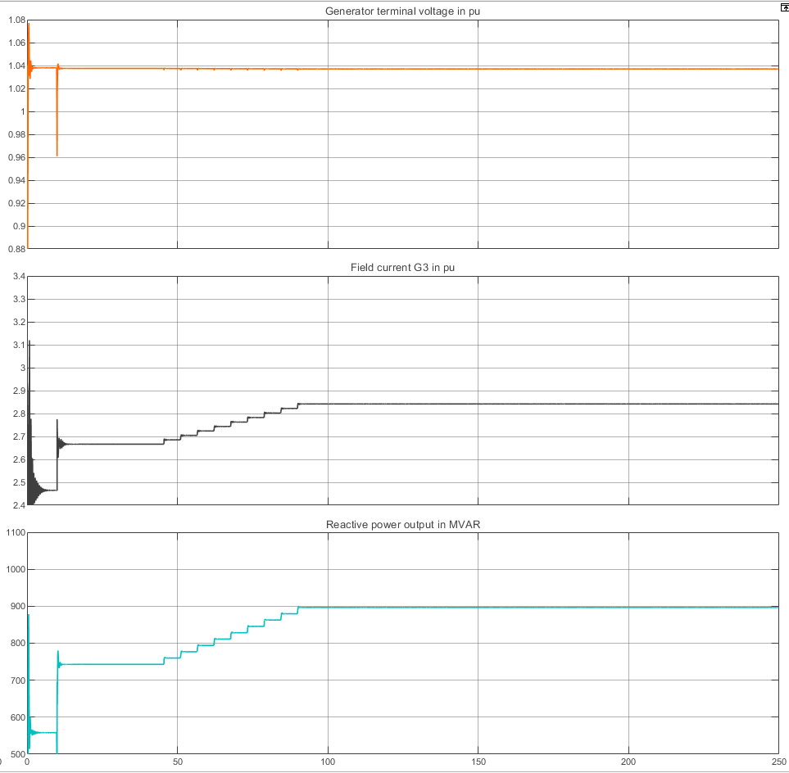
Perform Simulation Scenario 1
Load level 1 – Responses of G3 variables
Following the line outage, reactive power demand increases immediately due to the voltage drop.
During ULTC tap operation, reactive power output continues to increase to maintain voltage regulation.
The generator field current follows the same trend:
Increases sharply after the disturbance
increases gradually as ULTC continues tapping
For load level 1:
The field current is below its maximum limit
The Over-Excitation (OXL) is not activated
Therefore, the generator’s AVR maintains full voltage control

Slide 17
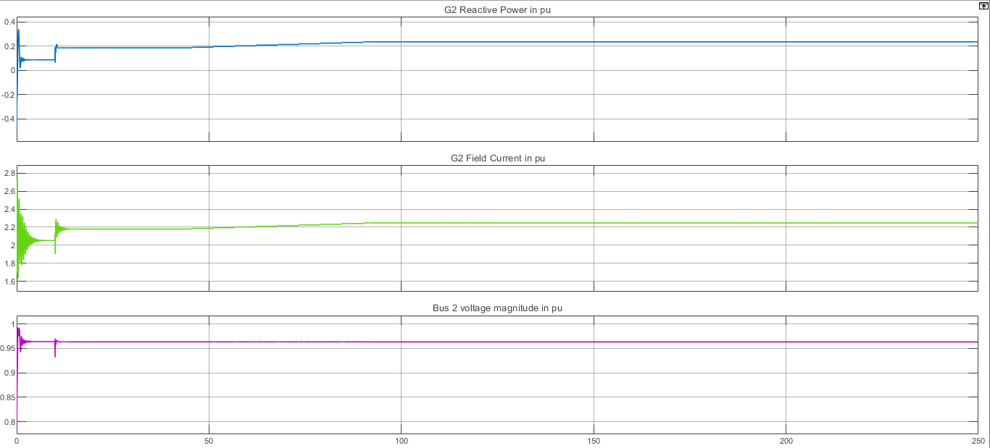
Perform Simulation Scenario 1
Load level 1 – Responses of G2 variables
Generator 2 increases its reactive power output and field current in response to the disturbance.
This increase supports voltage regulation in its local area.

Slide 18
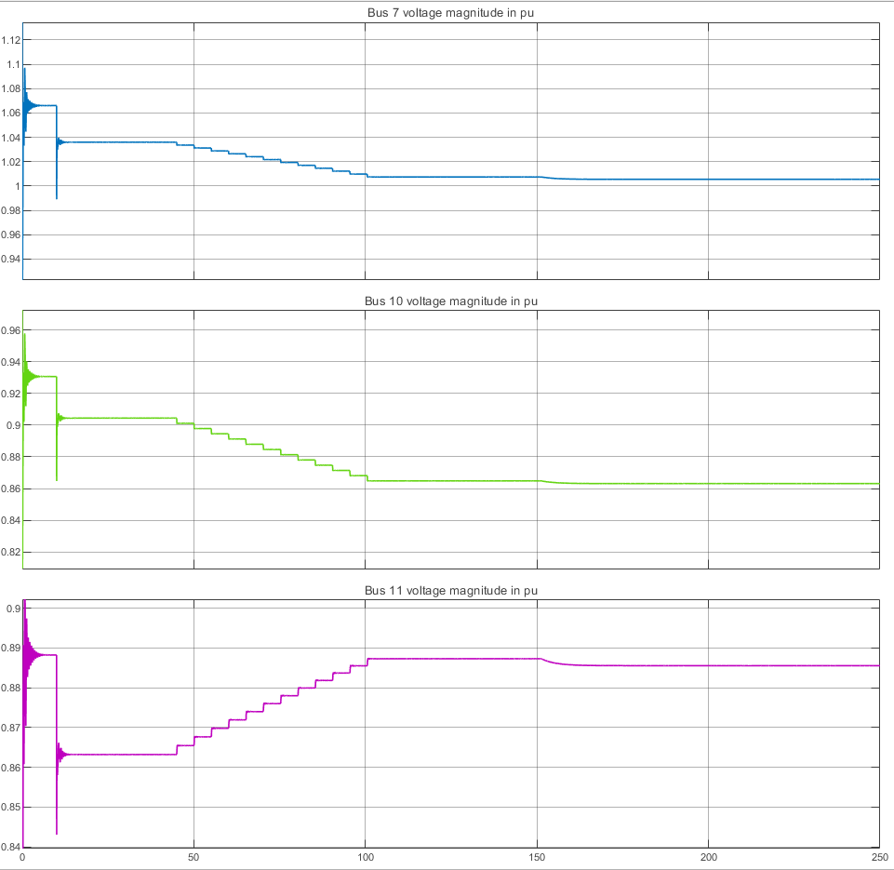
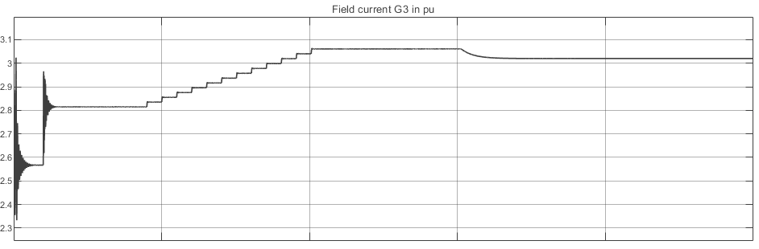
Perform Simulation Scenario 1
Load level 2- Responses of G3
After the line outage, the network impedance increases, resulting in a larger voltage drop compared to load level 1.
The ULTC transformer acts to restore Bus 11 voltage to its reference value.
During ULTC operation, voltages at buses 7 and 10 decrease further due to changes in the impedance seen from the upstream network.
Once Bus 11 voltage is restored, it temporarily remains at its reference value.
However, the generator field current exceeds its thermal limit.

Slide 19
Perform Simulation Scenario 1
However, the generator field current exceeds its thermal limit.
The field current can remain above the limit only for a short time.
When the limiter acts and reduces the field current:
The generator terminal voltage decreases
Voltages at downstream buses drop simultaneously
Any further ULTC attempt to restore the reference voltage:
Increases reactive power demand
reduce the generator voltage
Since the field current is limited, the generator cannot raise its voltage, leading to a further voltage reduction at Bus 11.

Slide 20
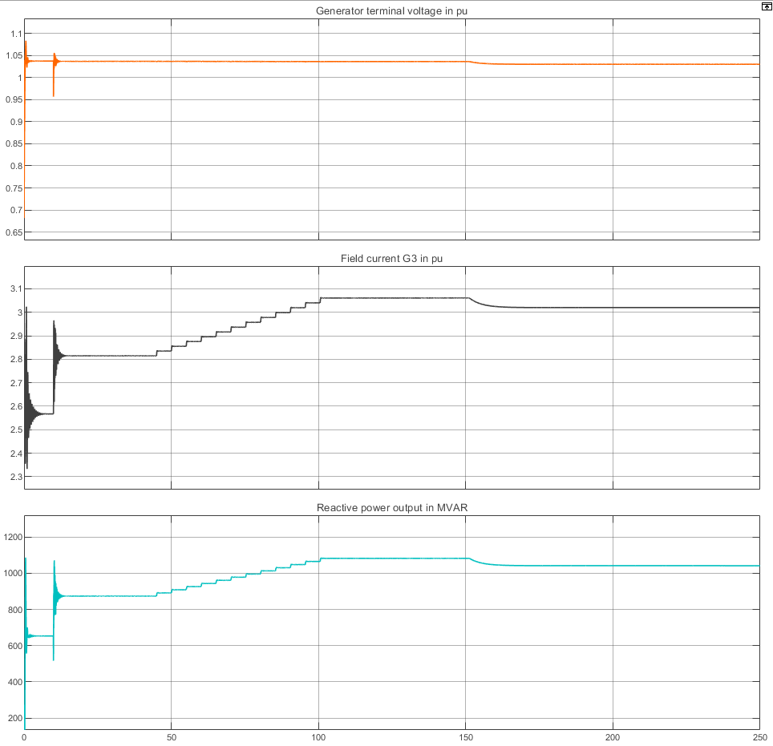
Perform Simulation Scenario 1
Load level 2- Responses of G3
Before and immediately after the fault, the generator voltage remains stable.
This stability is ensured by an increase in reactive power output and field current.
As loading increases and ULTC continues tapping, Reactive power and field current rise progressively
When the field current reaches its limit:
The generator loses voltage regulation capability
Terminal voltage begins to decrease
Voltage degradation becomes more severe after ULTC tap actions, which further increase reactive power demand.

Slide 21
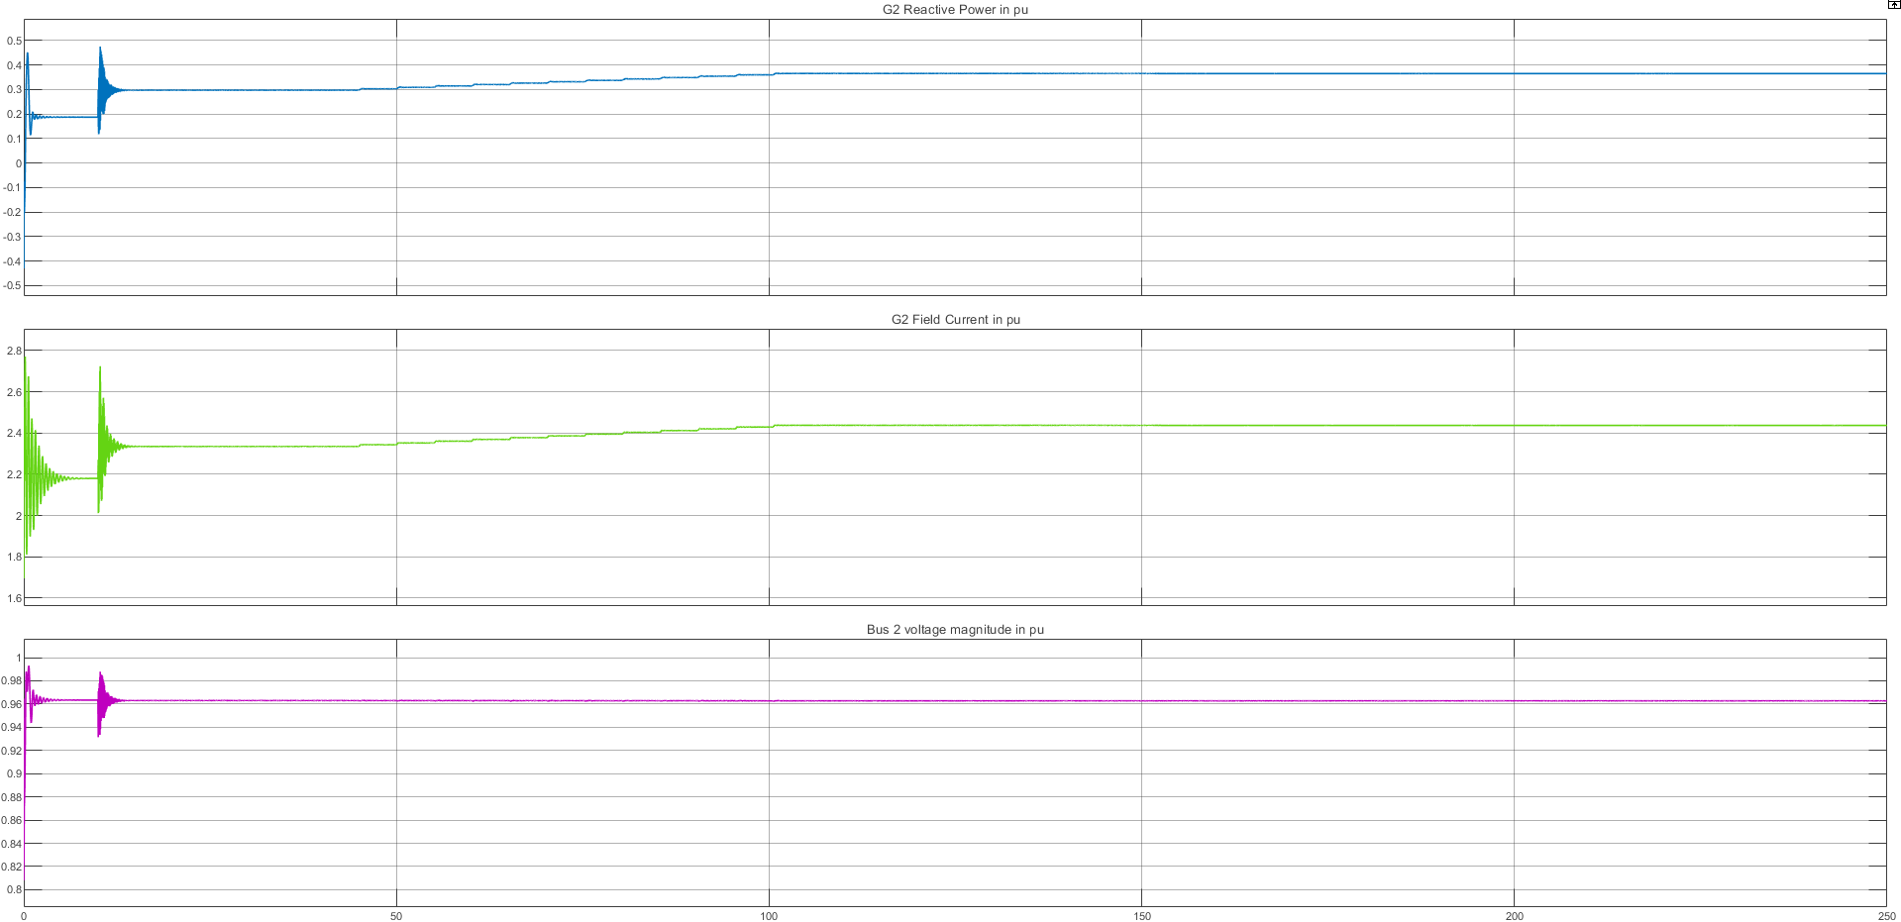
Perform Simulation Scenario 1
Load level 2- Responses of G2
Generator 2 shows an increase in reactive power output and field current following the disturbance.
This increase helps maintain voltage stability in its local area.
However, Generator 2 is electrically distant from Generator 3 and the weak load buses.
Due to transmission reactance and losses:
Most of Generator 2’s reactive power is absorbed by the network
Only a limited portion reaches the critical buses
Therefore, Generator 2 cannot compensate for the loss of voltage control in Generator 3, even though its reactive power output increases.

Slide 22
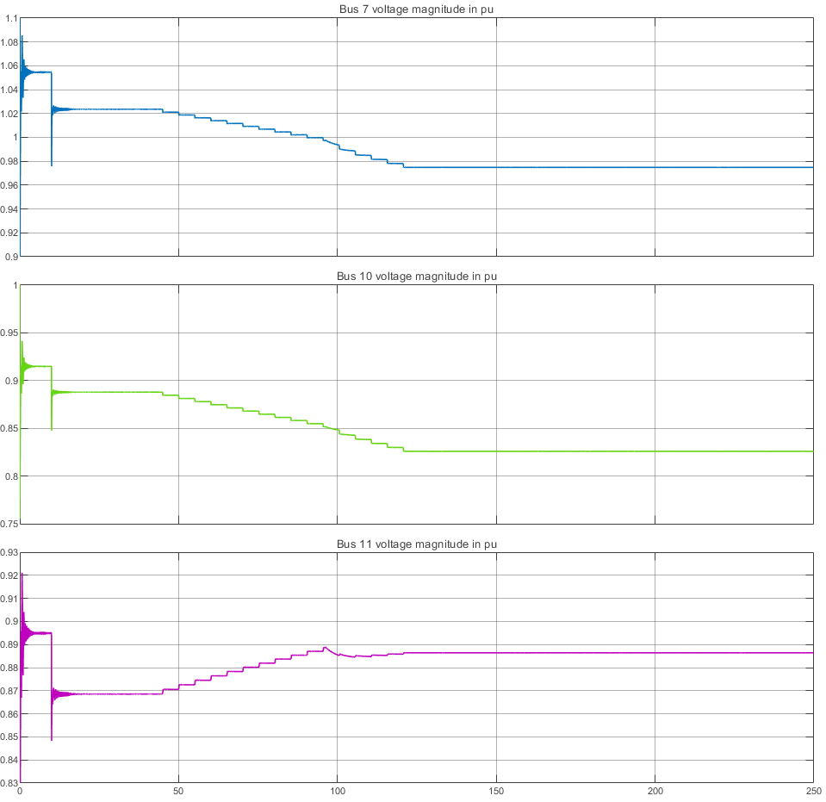
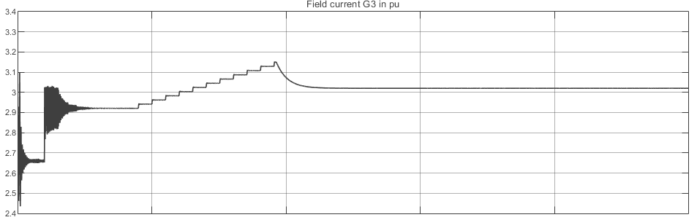
Perform Simulation Scenario 1
Load level 3
After the line outage, the network impedance increases significantly, causing a much larger voltage drop than in load levels 1 and 2.
The ULTC transformer attempts to restore Bus 11 voltage to its reference value.
At this high load level:
The generator field current increases sharply
It exceeds its thermal limit for a sufficient duration
As a result, the Over-Excitation Limiter (OXL) activates and forces the field current to decrease.

Slide 23
Perform Simulation Scenario 1
Load level 3
When the field current is reduced:
The generator terminal voltage drops
The voltage at Bus 11 decreases further
Any additional ULTC tap change:
Increases reactive power demand
reduce the generator voltage
This creates a repeating cycle.

Slide 24
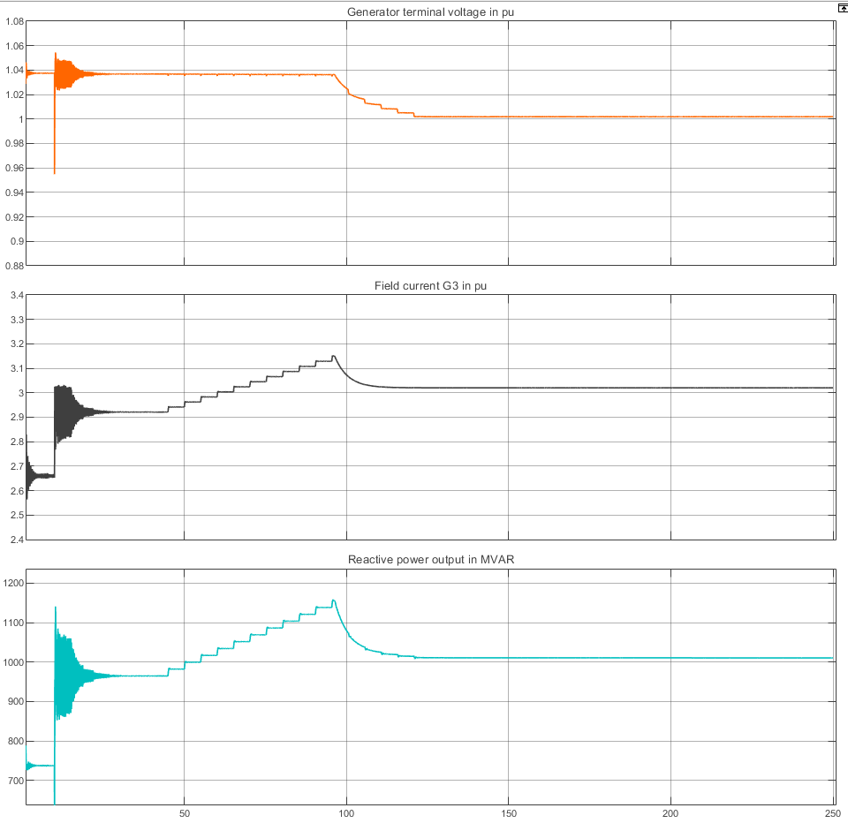
Perform Simulation Scenario 1
Load level 3- Responses of G3
Generator 3 maintains a stable terminal voltage only until the field current reaches its limit.
Once the field current is limited by the OXL:
The generator loses voltage regulation capability
At this point, any ULTC tap action further reduces the generator voltage
Voltage recovery becomes impossible

Slide 25
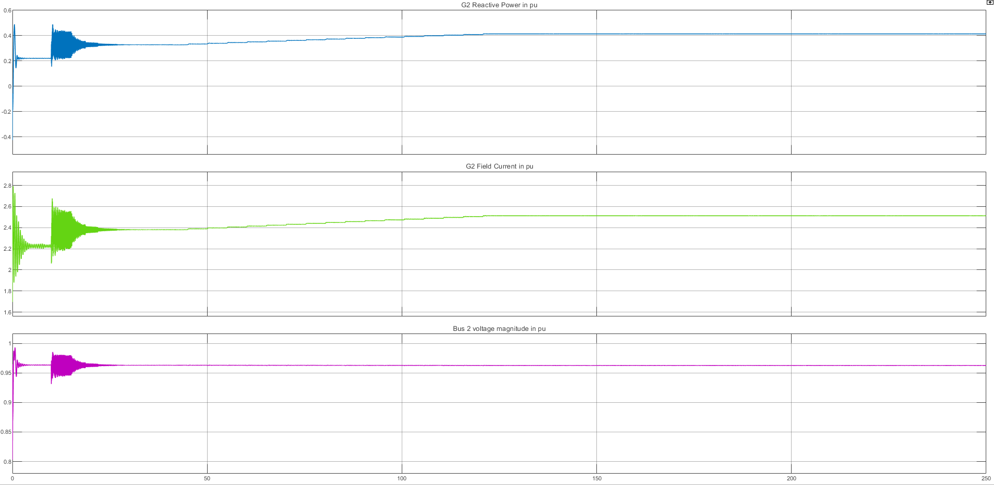
Perform Simulation Scenario 1
Load level 3 - Responses of G2
This behavior is similar to load level 2.
Although Generator 2 continues to supply reactive power
It is electrically remote from the weak load area
A large portion of its reactive power is consumed by network losses
Therefore, reactive power support from Generator 2 cannot compensate for the loss of voltage control in Generator 3.

Slide 26
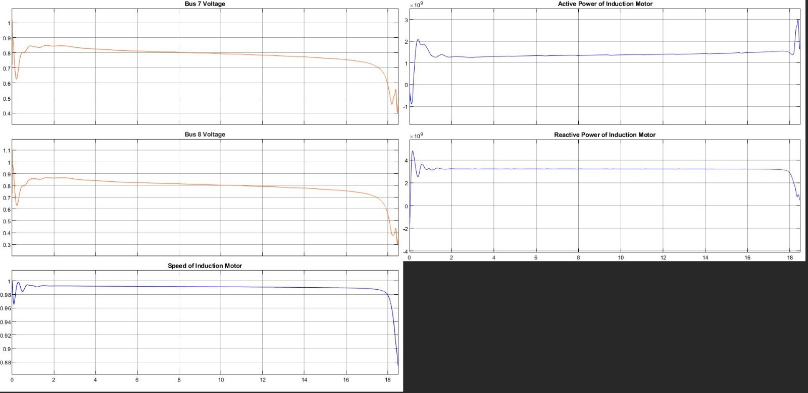
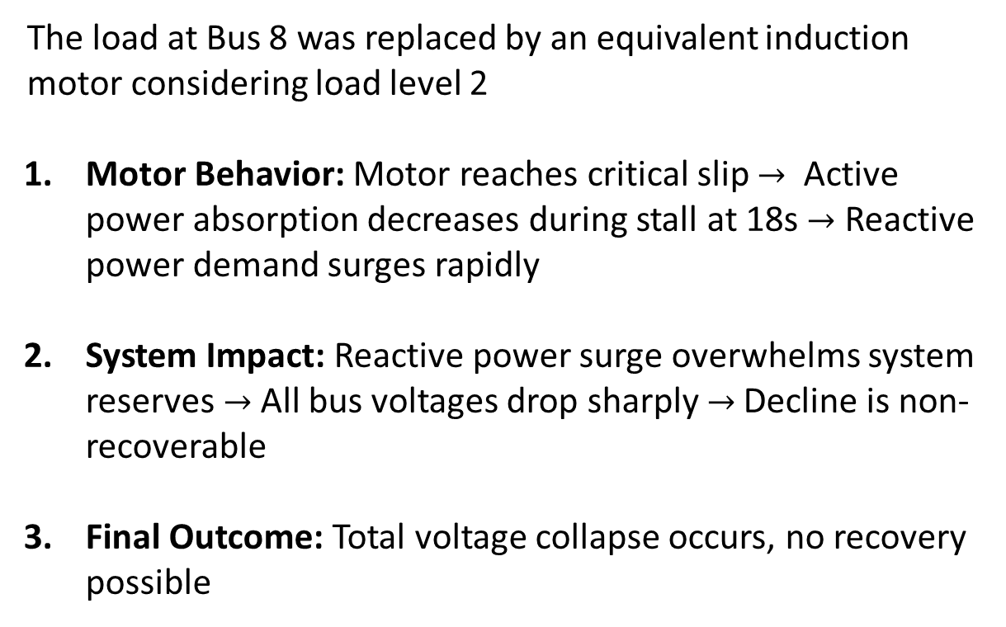
Perform Simulation Scenario 2
The load at Bus 8 was replaced by an equivalent induction motor considering load level 2
Motor Behavior: Motor reaches critical slip $→$ Active power absorption decreases during stall at 18s $→$ Reactive power demand surges rapidly
System Impact: Reactive power surge overwhelms system reserves $→$ All bus voltages drop sharply $→$Decline is non-recoverable
Final Outcome: Total voltage collapse occurs, no recovery possible

Slide 27
Conclusions
Scenario 1
Criterio | Level 1 | Level 2 | Level 3
Reactive Reserves | Sufficient | Limited | Insufficient
ULTC Outcome | Full restoration | Limited by taps | Fails to restore
G3 OXL | Not activated | Activated | Early activation
Bus 11 Voltage | Near nominal | Degraded | worst
System Stability | ✅ Stable | ⚠️ Stable (degraded) | ❌Stable (with more) stressed
Equilibrium | High quality | Lower, non-ideal | insufficient

Slide 28
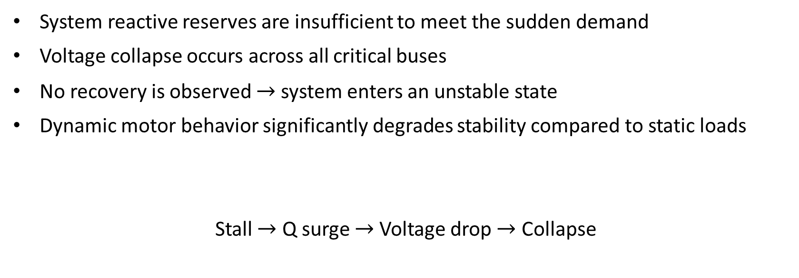
Conclusions
Scenario 2
System reactive reserves are insufficient to meet the sudden demand
Voltage collapse occurs across all critical buses
No recovery is observed $→$ system enters an unstable state
Dynamic motor behavior significantly degrades stability compared to static loads
Stall $→$ Q surge $→$ Voltage drop $→$ Collapse

Slide 29
Conclusions
Overall Project
Load Level: Load increase leads to increase the reactive demand and reduces the stability margin.
Load types: with static loads System stabilizes via ULTC + generator reserves while for dynamic load interaction the reactive demand exceeds supply and leads to voltage collapse
The voltage collapse depends on the reactive reserves available
Induction motor dynamics significantly reduce voltage stability margin
Transient reactive demands are more critical than steady-state loading
Protection schemes must account for motor stalling as a collapse trigger

Slide 30
Conclusions
Overall Project
Increased system load raises reactive power demand and reduces the stability margin.
Load Type Comparison:
  Static loads: System stabilizes via ULTC action + generator reactive reserves.
  Dynamic loads (induction motors): Transient reactive demand exceeds supply, leading to voltage collapse.
Voltage collapse depends primarily on available reactive power reserves.
Induction motor stalling significantly reduces the system's voltage stability margin.
Transient Q demands are more critical than steady-state loading for stability.
Protection schemes must account for motor stalling as a potential voltage collapse trigger.

